Slide 1


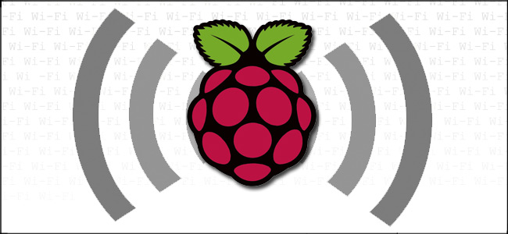

The WiPi Flood Detector Program 5 Internet of Things
Viren Mody

Slide 2
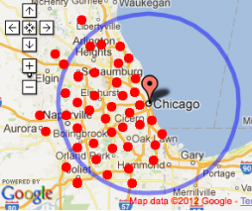
Sales Pitch: Flood Detector
Do you live in the circled area?
Do you live in a house with basement?
…Chances are you’ve dealt with flooding
…chances are you’ll deal with flooding again

Slide 3

In Chicago…

Slide 4

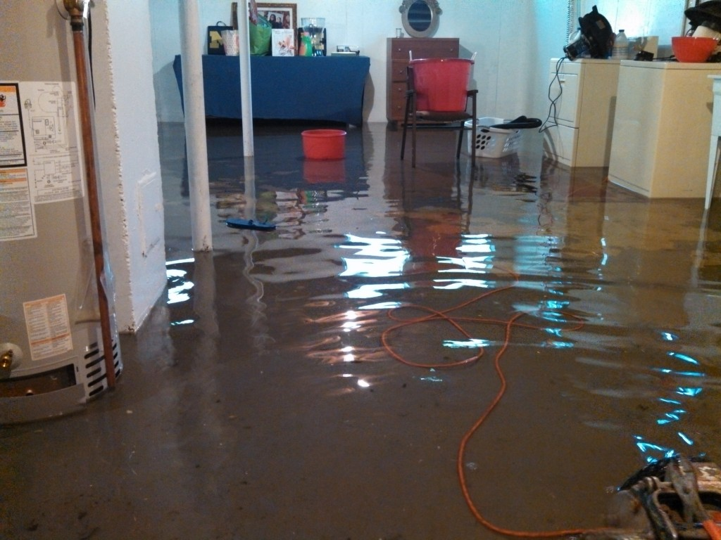
Sales Pitch: Flood Detector

Slide 5
You need the wipi flood detector
When water level exceeds the sump pump in the sump pump pit…
Sends text/notification alerts via pushbullet
Sends a second alert will notify you of...
the rate water level is increasing in the pit
How far water is from overflowing the sump pump pit into your basement
How much time you have before overflowing happens

Slide 6
Sales Pitch: Flood Detector
Dealt with flooding
Sump Pump
Additional Sump pump
Drain tile
Rain water or CITY SEWER BACKUP
sugar
Implemented 5th of the 5 original ideas I had
Concept of water detection is the same, however it was not implemented in sewer where city sewer backup happens. I “implemented” in sump pump pit.

Slide 7
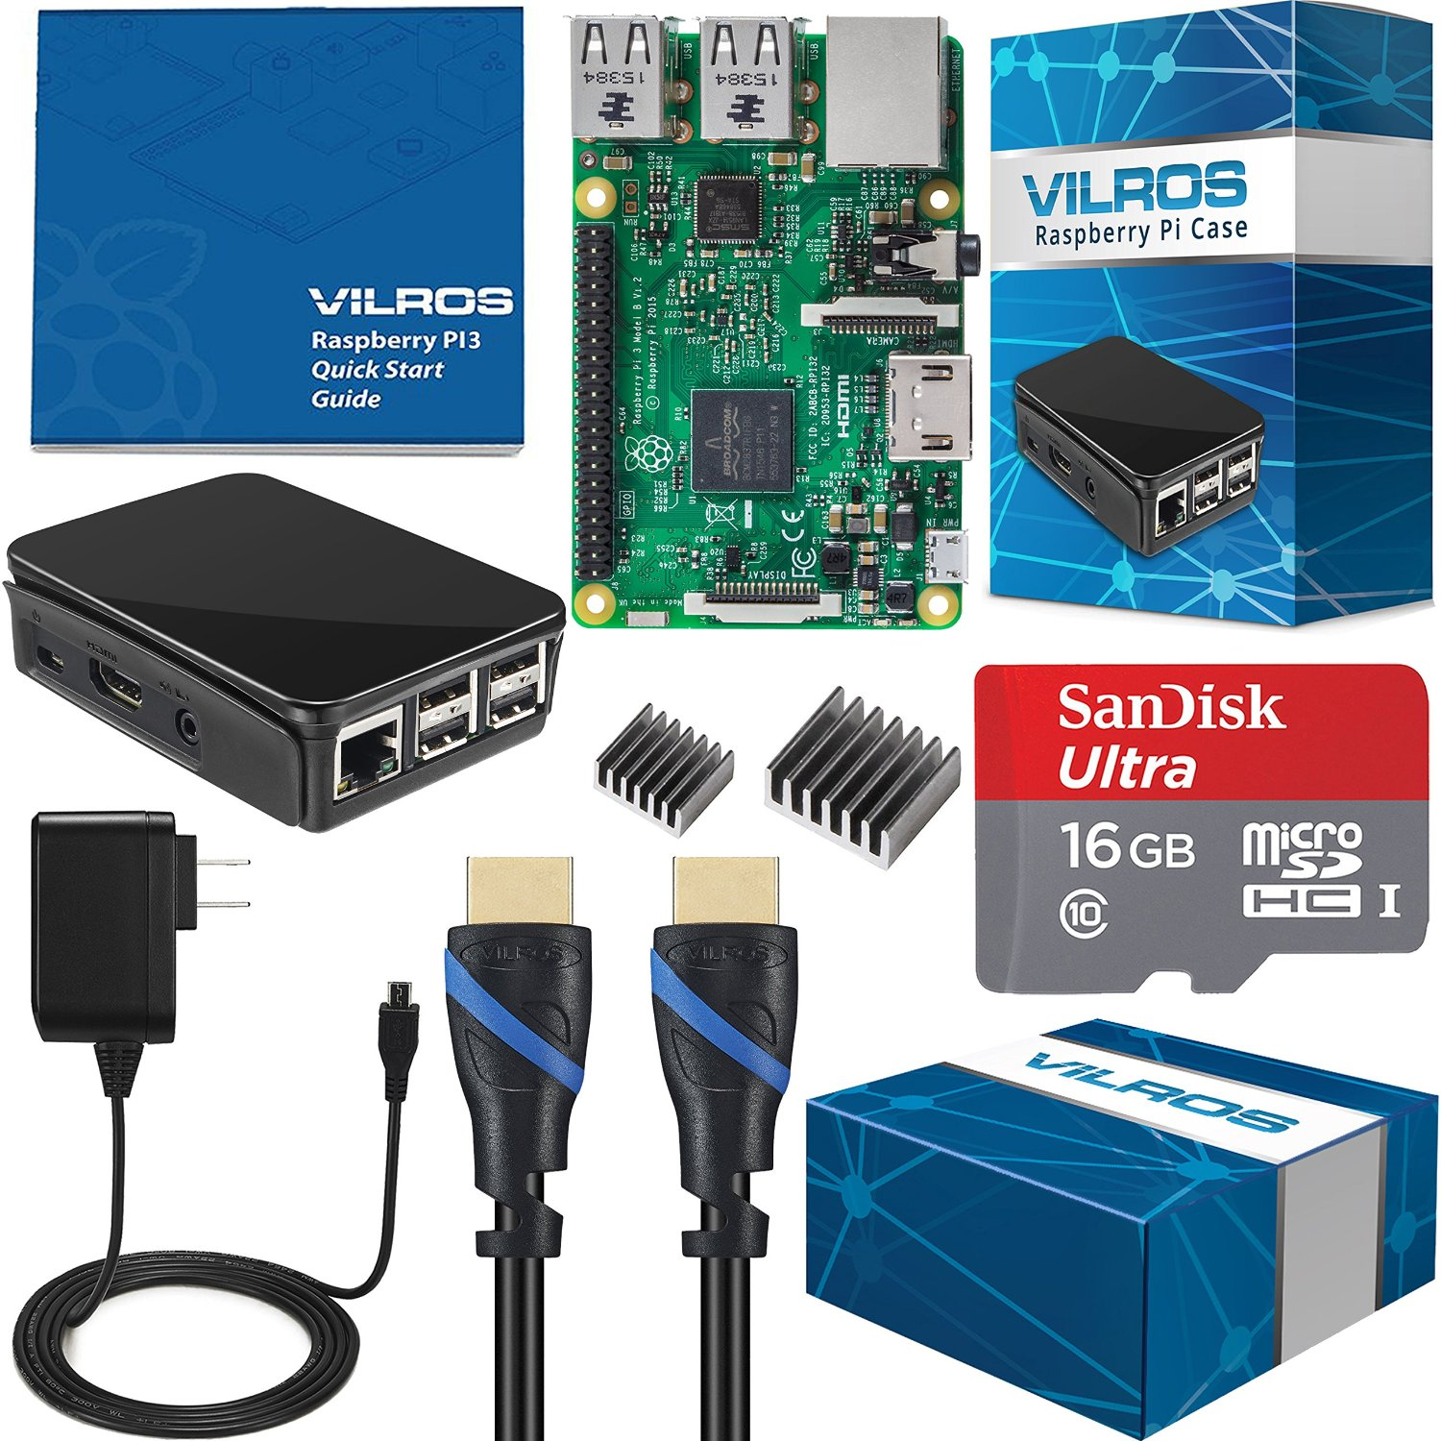
IoT Device
Vilros Raspberry Pi Complete Starter Kit
Raspberry Pi 3 Model B
Raspberry Pi Enclosure Case (Black)
16GB Micro Sd Card Preloaed with NOOBS
2500 mA Micro USB Power Supply
High Quality HDMI Cable
Set of 2 Heatsinks
1 year warranty
COST: $64.99

Slide 8
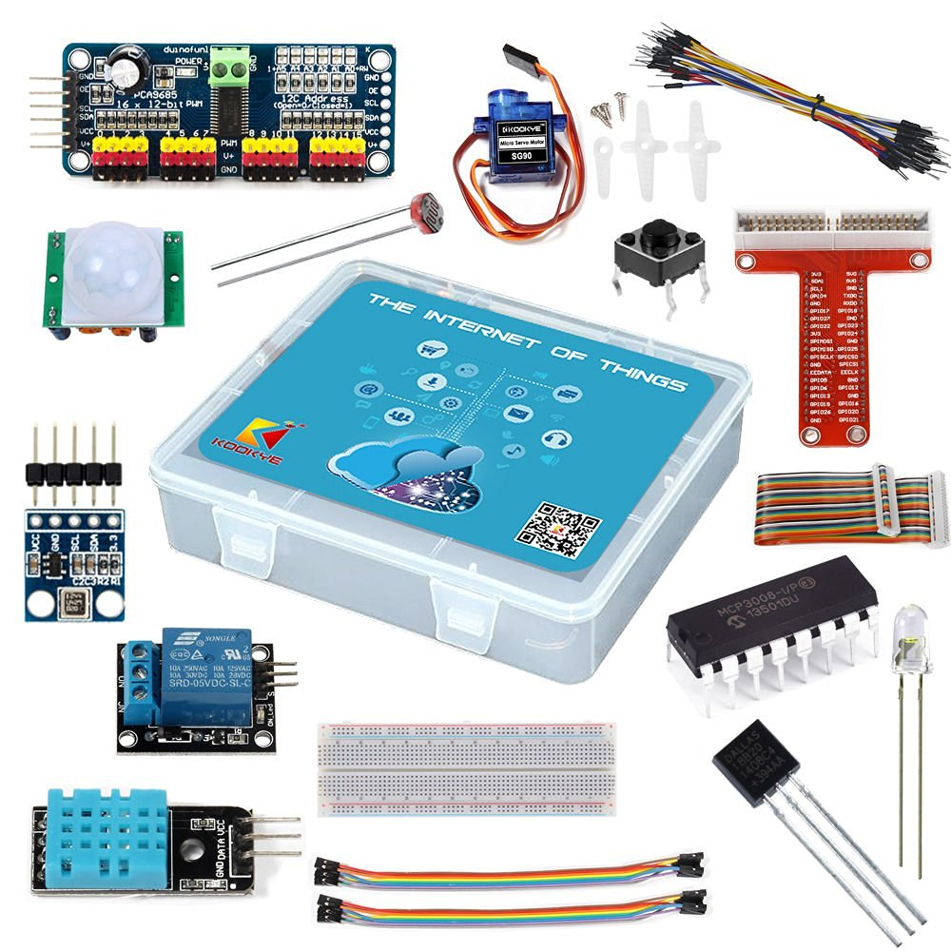
IoT Device ACCESSORIES
KOOKYE Raspberry Pi IoT Starter Kit Internet of Things for Raspberry Pi 2 / 3
1 x Solderless Prototype Breadboard
1 x GPIO to Breadboard 40-pin breakout interface
Jumper Wires(2 x 8pin female to female 20cm)
Jumper Wires(1 x 40pin male to male 15cm)
LED (6 x Bright White, 6 x Red, 6 x Yellow, 6 x Green)
3 x Photoresistor (light sensor)
1 x MCP3008 A/D converter - Doesn’t work with water sensors on pi!!
5 x push buttons
1 x DHT11 Temperature/Humidity sensor
1 x DS18B20 Temperature sensor
1 x Digital Motion sensor
1 x servo motor
1 x BMP180 Pressure/Temperature Sensor
1 x Relay1 x PCA9685 PWM I2C Controller
COST: $29.99
BEWARE: NO RESISTORS!!! =O !!!

Slide 9
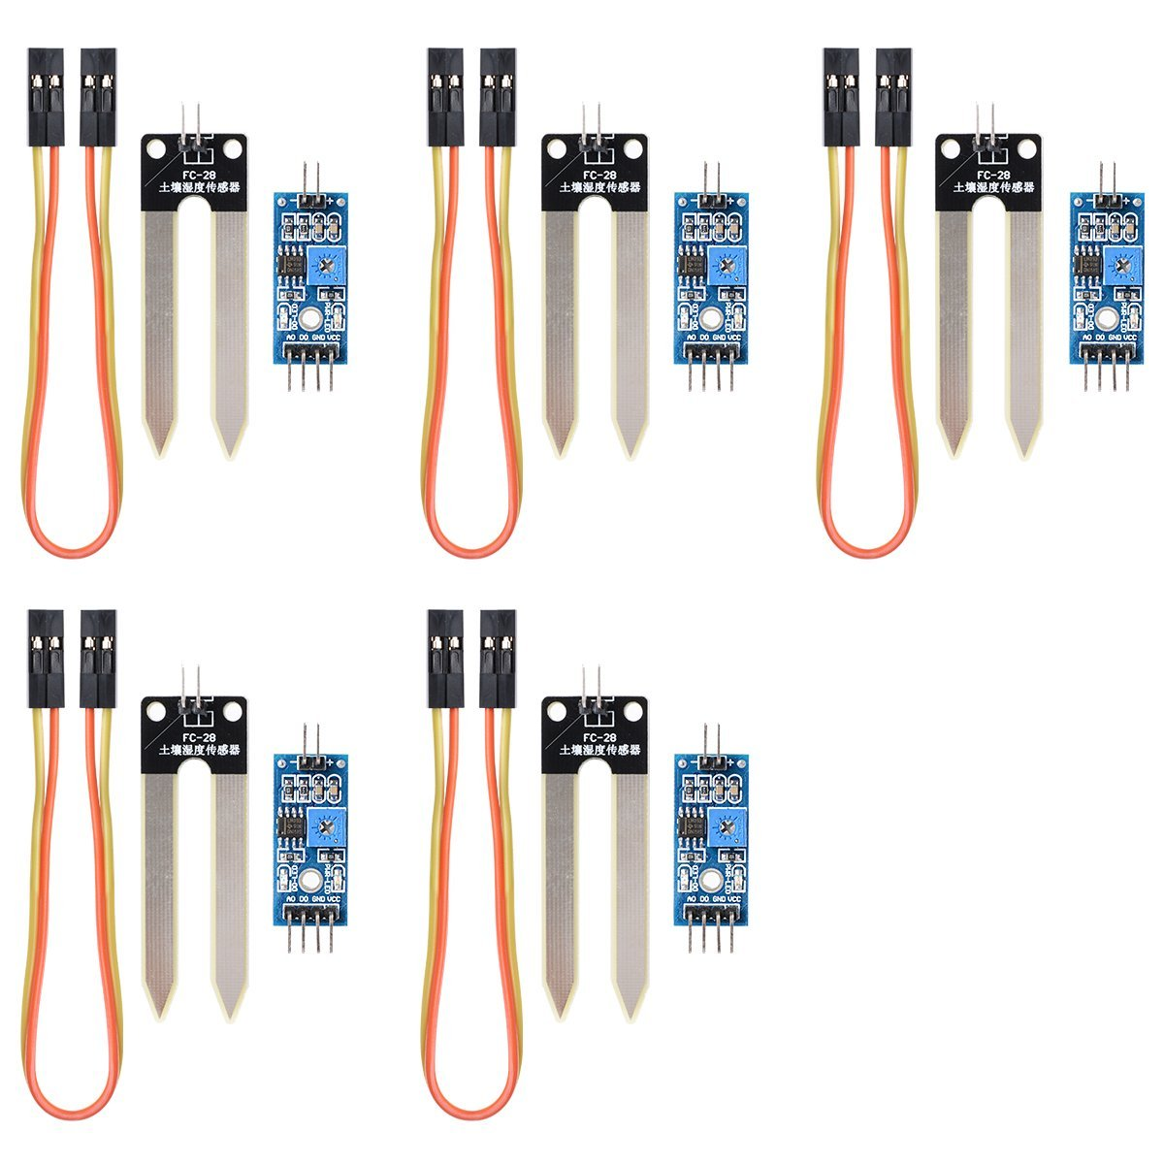
IoT Device ACCESSORIES
XCSOURCE Soil Moisture Sensor FOR pi/Arduino – 5 pCs
COST: $7.99 + $5.99 Rush shipping =(
BEWARE: THESE ARE CHEAP AND DON’T Last Long

Slide 10
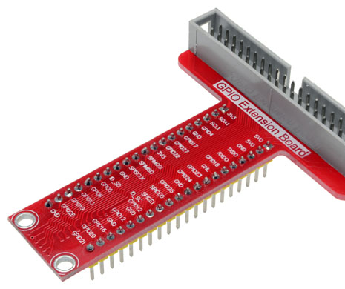
THE GROWING PAINS of the DEVELOPMENT PROCESS
No experience with hardware/circuitry and never took 362
Spent more $$$ than I needed to…
Kookye kit: Fool ME ONCE SHAME ON YOU, FOOL ME TWICE SHAME ON ME, Fool Me thrice, shame on me more!
GPIO T Board - ON PIAZza @236
Mpc3008 included, but doesn’t work with water sensors, had to buy MPC3002
No Resistors!!!

Slide 11
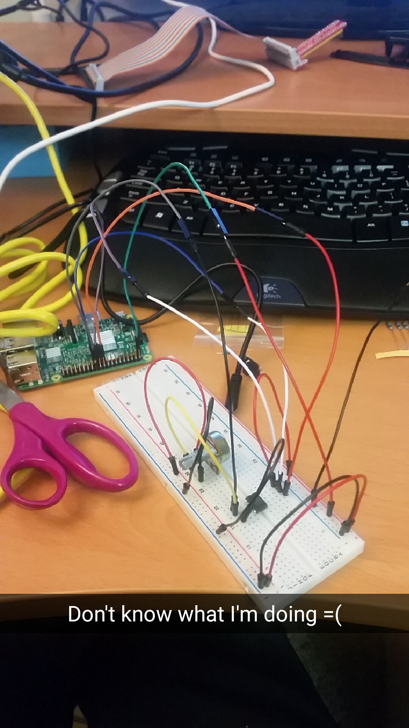
THE DEVELOPMENT PROCESS Hardware
Take 1
Raspberry pi = digital input only
Water sensor = analog output only
Possible with an ADC MPC3002
Proved to be difficult for me as a beginner…

Slide 12
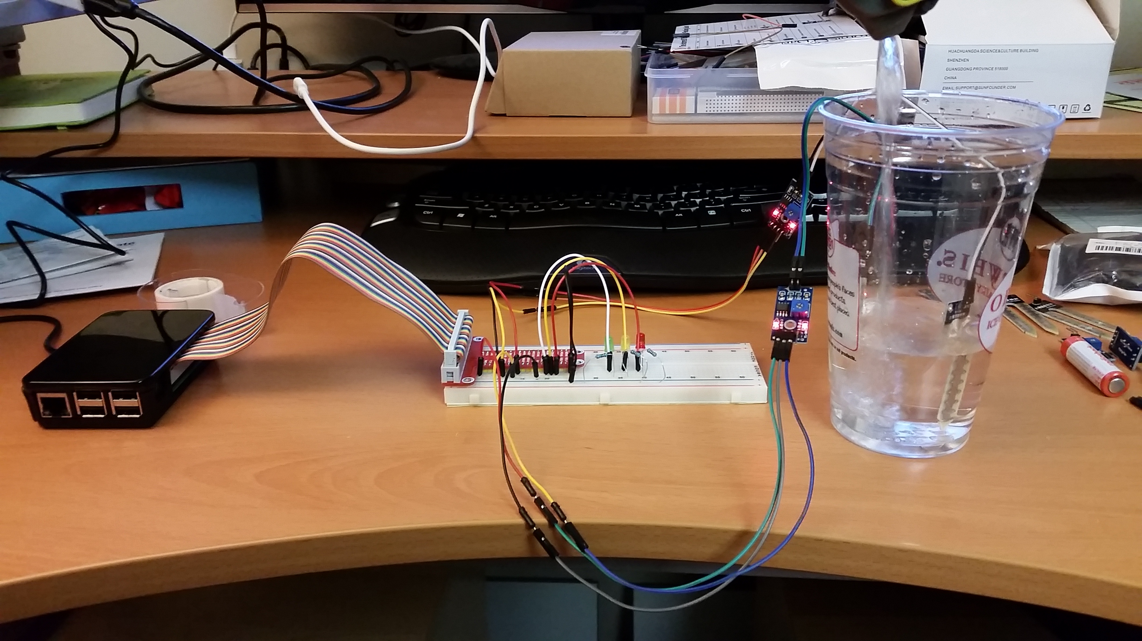
THE DEVELOPMENT PROCESS Hardware
Take 2
Raspberry pi = digital input only
Dual mode moisture sensor – used digital output
data Transmission: GPIO PINS
Relative to take 1 – piece of cake
Hw challenges
Cheap water/moisture sensors
See piazza @241

Slide 13
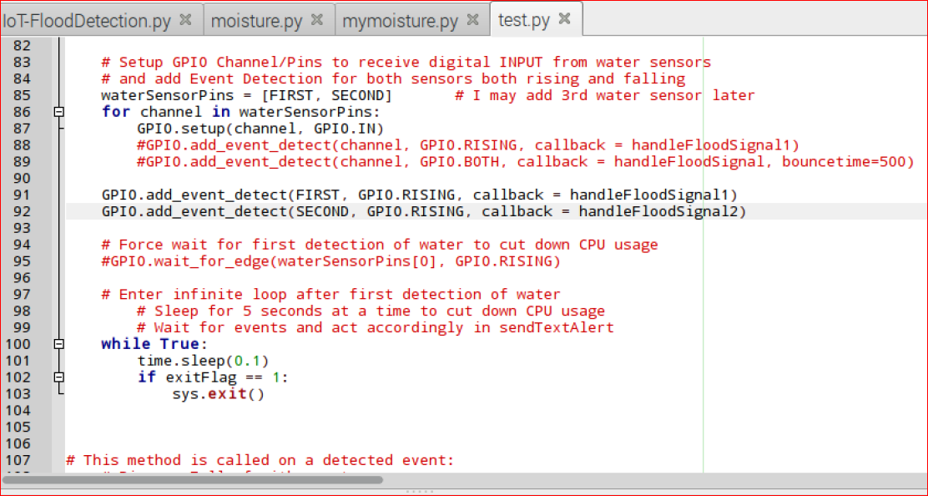
The Development Process Software
Had to learn some python
Read up on similar water sensing projects
Slow and steady wins the race and function decomposition style approach
First Simple projects
Light up an led
Light up multiple leds
Then One puzzle piece at a time
Simple water sensing
Send an email
Send a text/notification
Finally combined them all

Slide 14
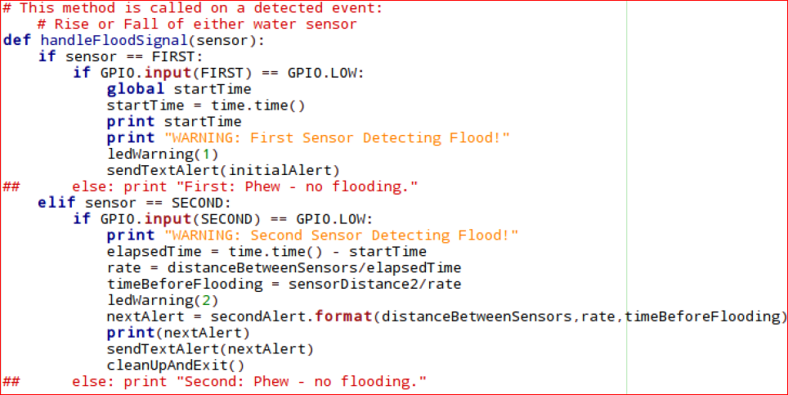
One problem…
One callback function to handle both sensors
Problem: inconsistent results
Sometimes 2nd sensor wouldn’t trigger
Sometimes 1st sensor would trigger multiple times
Solution:
two functions = two signal handlers

Slide 15
Main Resources used
https://www.hackster.io
https://sourceforge.net
https://docs.python.org
https://www.youtube.com/
Syed
Laurentiu

Slide 16
Future work and advice
Sense if water level drops below sensors and alert me
Use a rain sensor outside to trigger flood detector script
Use digital output on a water/moisture sensor for this project because analog data is not necessary – simple yes/no for water shall suffice

Slide 17
video

